Slide 1
UNIT III
Supervised Learning
Classification
Bayesian Concept Learning

Slide 2
Why Bayesian methods are important
Highly practical approaches to certain to certain types of learning problems - can calculate explicit probabilities of hypotheses
Equally competitive or even outperform other learning algorithms including decision tree, neural network
Bayesian classifiers uses – simple idea –
training data are utilized to calculate an observed probability of each class based on feature values
Applies prior knowledge or prior belief to the probability of the outcome – higher probability of meeting the actual or real-life outcome

Slide 3
Examples uses of Bayesian classifiers
Text based classification such as spam or junk mail filtering, author identification or topic categorization
Medical diagnosis such as given the presence of set of observed symptoms during a disease – probability of new patients having disease
Network security such as detecting illegal intrusion or anomaly in computer networks

Slide 4
Features of Bayesian learning methods:
Prior knowledge can be combined with observed data to determine the final probability of a hypothesis
the Bayesian approach to learning is more flexible than other approaches – each observed training pattern can influence the outcome of the hypothesis
Can perform better than the other methods while validating the hypotheses that make probabilistic predictions
Possible to classify new instances by combining the predictions of multiple hypotheses
Used as a standard for the optimal decision against which the performance of other methods can be measured

Slide 5
Bayes Theorem
In machine learning, we try to determine the best hypothesis from some hypothesis space H, given the observed training data T.
In Bayesian learning, the best hypothesis means the most probable hypothesis, given the data T plus any initial knowledge about the prior probabilities of the various hypotheses in H.
Bayes theorem provides a way to calculate the probability of a hypothesis based on its prior probability, the probabilities of observing various data given the hypothesis, and the observed data itself.

Slide 6
Cont..
Prior
P(h) is prior probability of hypothesis h
P(h) to denote the initial probability that hypothesis h holds, before observing training data.
P(h) may reflect any background knowledge we have about the chance that h is correct. If we have no such prior knowledge, then each candidate hypothesis might simply get the same prior probability.
P(T) is prior probability of training data T
The probability of T given no knowledge about which hypothesis holds

Slide 7
Cont..
Posterior
P(h|T) is posterior probability of h given T
P(h|T) is called the posterior probability of h, because it reflects our confidence that h holds after we have seen the training data T.
The posterior probability P(h|T) reflects the influence of the training data T, in contrast to the prior probability P(h), which is independent of T.
P(T|h) is posterior probability of T given h
The probability of observing data T given some world in which hypothesis h holds
Generally, P(A l B) to denote the probability of event A given event B or , probability of event A occurring when event B has already occurred

Slide 8
Cont..
In ML problems the probability P(h|T) that h holds given the observed training data T.
provides a way to calculate the posterior probability P(h|T), from the prior probability P(h), together with P(T) and P(T|h).
Bayes Theorem: - combines prior and posterior probabilities
P(h|T) = P(T|h) P(h) / P(T)
P(h|T) increases with P(h) and P(T|h) according to Bayes theorem.
P(h|T) decreases as P(T) increases, because the more probable it is that T will be observed independent of h, the less evidence T provides in support of h.

Slide 9
Bayes Theorem - Example
A holds | T | T | F | F | T | F | T
B holds | T | F | T | F | T | F | F
Sample space of events for A & B
P(A) = 4/7 P(B) = 3/ 7 P(B|A) = 2/4 P(A|B) = 2/3
Is Bayes Theorem correct?
P(B|A) = P(A|B)P(B) / P(A) = ( 2/3 * 3/7 ) / 4/7 = 2/4
CORRECT
P(A|B) = P(B|A)P(A) / P(B) = ( 2/4 * 4/7 ) / 3/7 = 2/3
CORRECT

Slide 10
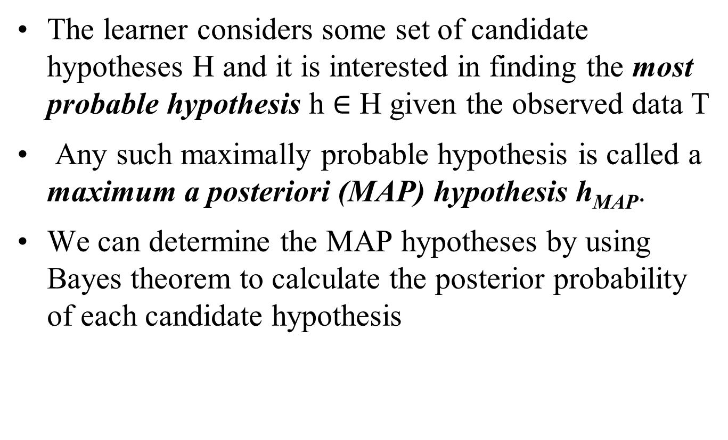
Maximum A Posteriori (MAP) Hypothesis, h_{MAP}
The learner considers some set of candidate hypotheses H and it is interested in finding the most probable hypothesis h $∈$ H given the observed data T
Any such maximally probable hypothesis is called a maximum a posteriori (MAP) hypothesis h_{MAP}.
We can determine the MAP hypotheses by using Bayes theorem to calculate the posterior probability of each candidate hypothesis

Slide 11
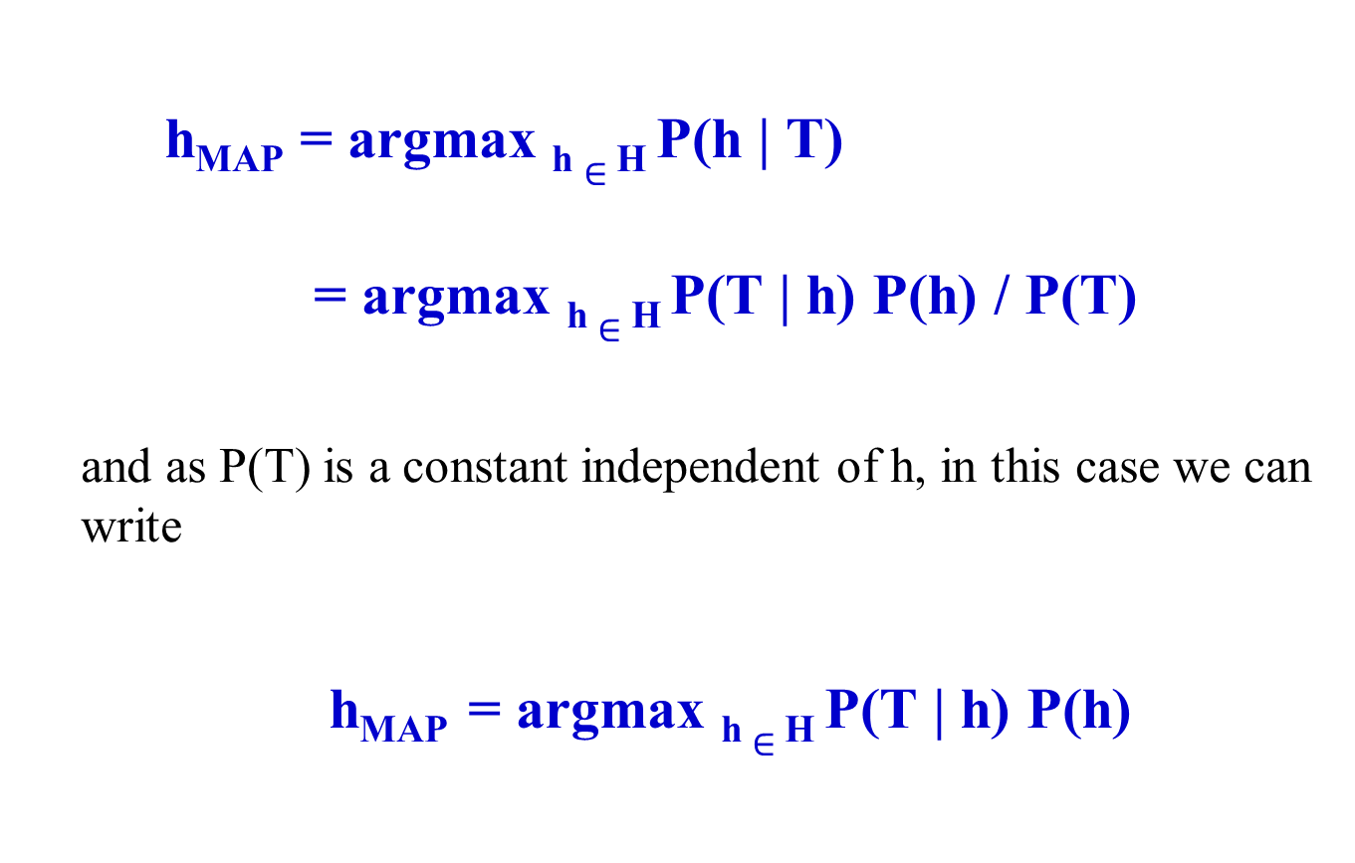
h_{MAP} = argmax _{h} $∈$ _{H} P(h | T)
= argmax _{h} $∈$ _{H} P(T | h) P(h) / P(T)
and as P(T) is a constant independent of h, in this case we can write
h_{MAP} = argmax _{h} $∈$ _{H} P(T | h) P(h)

Slide 12
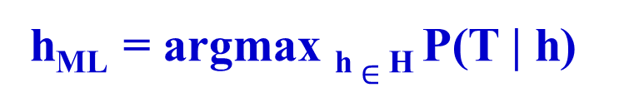
Maximum Likelihood (ML) Hypothesis, h_{ML}
If we assume that every hypothesis in H is equally probable
i.e. P(h_{i}) = P(h_{j}) for all h_{i} and h_{j} in H
We can only consider P(T|h) to find the most probable hypothesis
P(T|h) is often called the likelihood of the data T given h
Any hypothesis that maximizes P(T|h) is called a maximum likelihood (ML) hypothesis, h_{ML}.
h_{ML} = argmax _{h} $∈$ _{H} P(T | h)

Slide 13
Prior
Bayes
Posterior
Data
Prior
Likelihood
P(h|T) = P(T|h) P(h) / P(T)
Posterior Probability
Marginal likelihood
Concept of prior, posterior and likelihood

Slide 14
Example: Does patient have cancer or not?
A patient takes a lab test and the result comes back positive. The test returns a correct positive result in only 98% of the cases in which the disease is actually present, and a correct negative result in only 97% of the cases in which the disease is not present. Furthermore, .008 of the entire population have this cancer
P(cancer) = .008 P(¬cancer) = .992
P(+|cancer) = .98 P(−|cancer) = .02
P(+|¬cancer) = .03 P(−|¬cancer) = .97

Slide 15
Brute-Force Bayes Concept Learning
A Concept-Learning algorithm considers a finite hypothesis space H defined over an instance space X
The task is to learn the target concept (a function) c : X -> {0,1}
X is the instance space corresponding to H
The learner gets a set of training examples ( <x₁,t_{l}>, <x₂,t₂> . . . <x_{m},t_{m}> )
where x_{i} is an instance from X and t_{i} is its target value (i.e. c(x_{i}) = t_{i} ).
Brute-Force Bayes Concept Learning Algorithm finds the maximum a posteriori hypothesis (h_{MAP}), based on Bayes theorem.

Slide 16
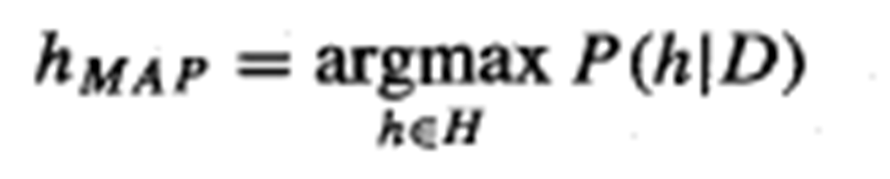
Brute-Force Bayes Concept Learning
For each hypothesis h in H, calculate the posterior probability
P(h|T) = P(T| h)P(h) / P(T)
Output the hypothesis h_{MAP} with the highest posterior probability
This algorithm may require significant computation, because it applies Bayes theorem to each hypothesis in H to calculate P(h|T)
While this is impractical for large hypothesis spaces,
The algorithm is still of interest because it provides a standard against which we may judge the performance of other concept learning algorithms

Slide 17
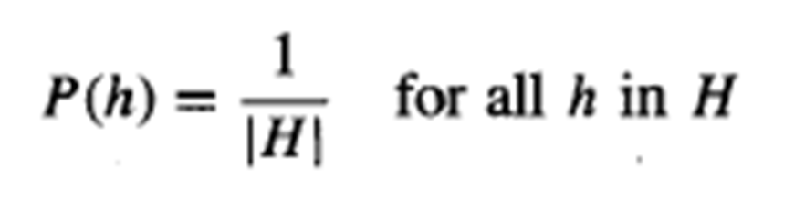
Cont..
BF MAP learning algorithm must specify values for P(h) and P(T|h).
P(h) and P(T|h) must be chosen to be consistent with the assumptions:
The training data T is noise free (i.e., t_{i} = c(x_{i})).
The target concept c is contained in the hypothesis space H
We have no a priori reason to believe that any hypothesis is more probable than any other.
With these assumptions:
P(T|h) = 1 if t_{i} = h(x_{i}) for all t_{i} within T
0 otherwise

Slide 18
Cont..
Using Bayes' theorem to identify the posterior probability
For the cases where h is inconsistent with the training data T, we get
P(h|T) = 0 * P(h) / P(T) = 0, when h is inconsistent with T
And
P(h|T) = (1 * 1/ |H| ) / P(T) = 1/|H| P(T), when h is consistent
If HD is a subset of hypothesis H which is consistent with T then,

Slide 19
Cont..

Slide 20
Evolution of posterior probabilities P(h|D) with increasing training data
P(h)
P(h|T₁)
P(h|T₁∧T₂)
hypotheses
hypotheses
hypotheses
(a) Uniform priors assign equal probability to each hypothesis.
(b) As training data increases first to Tl
(c) then to Tl ^ T2
the posterior probability of inconsistent hypotheses becomes zero, while posterior
probabilities increase for hypotheses remaining in the version space

Slide 21
Bayes Optimal Classifier
"what is the most probable hypothesis given the training data?‘
"what is the most probable classification of the new instance given the training data?
Applying the MAP hypothesis to the new instance,
in fact it is possible to do better.

Slide 22
Bayes Optimal Classifier
Consider hypotheses, hl, h2, and h3
Suppose that the posterior probabilities of these hypotheses given the training data are .4, .3, and .3 respectively. Thus, hl is the MAP hypothesis.
A new instance x is encountered, which is classified positive by hl, but negative by h2 and h3.
Taking all hypotheses –
the probability that x is positive is .4 (the probability associated with hi), and the probability that it is negative is therefore .6.
The most probable classification (negative) in this case is different from the classification generated by the MAP hypothesis.
Any system that classifies new instances according to this is called a Bayes optimal classifier, or Bayes optimal learner

Slide 23
Bayes Optimal Classifier
Bayes optimal classification:
Example: H = {h₁, h₂, h₃}, The set of possible outcomes for the new instance x is within the set C={True,False}
P(h₁ | T) = .4 P(false | h₁) = 0 P(true | h₁) = 1
P(h₂ | T) = .3 P( false| h₂) = 1 P(true | h₂) = 0
P(h₃ | T) = .3 P(false | h₃) = 1 P(true | h₃) = 0

Slide 24
Naïve Bayes Classifier
Assume target function f : X → C each instance x described by attributes ⟨a₁, …, a_{n}⟩
In simplest case, C has two values (0,1)
Most probable value of f (x) is:
Naïve Bayes assumption:
Naïve Bayes classifier:

Slide 25
Strengths and weaknesses of Bayes classifers
Strengths | Weakness
Simple and fast in calculation but yet effective in results | The basis assumption of equal importance an independence often does not hold true
In situations where there are noisy and missing data, it performs well | If the target datasets contains large numbers of numeric features, then the reliability of the outcome becomes limited
Works equally well when small number of data is present for training as well as very large number of training data is available | Though the predicted classes have a high reliability, estimated probabilities have relatively lower reliability
Easy and straightforward way to obtain the estimated probability of a prediction

Slide 26
Naïve Bayes Classifier Steps
Step 1 : Construct Frequency Table – for each attribute against the target outcome
Step 2: Identify the cumulative probability for the target class on the basis of all the attributes.
Step 3: Calculate probability through normalization by applying the below formula
P(Yes) = P(Yes) / (P(Yes) + P(No))
P(No) = P(No) / (P(Yes) + P(No))
P(Yes) – will give the overall probability of favorable condition in the given scenario
P(No) – will give the overall probability of non-favorable condition in the given scenario

Slide 27
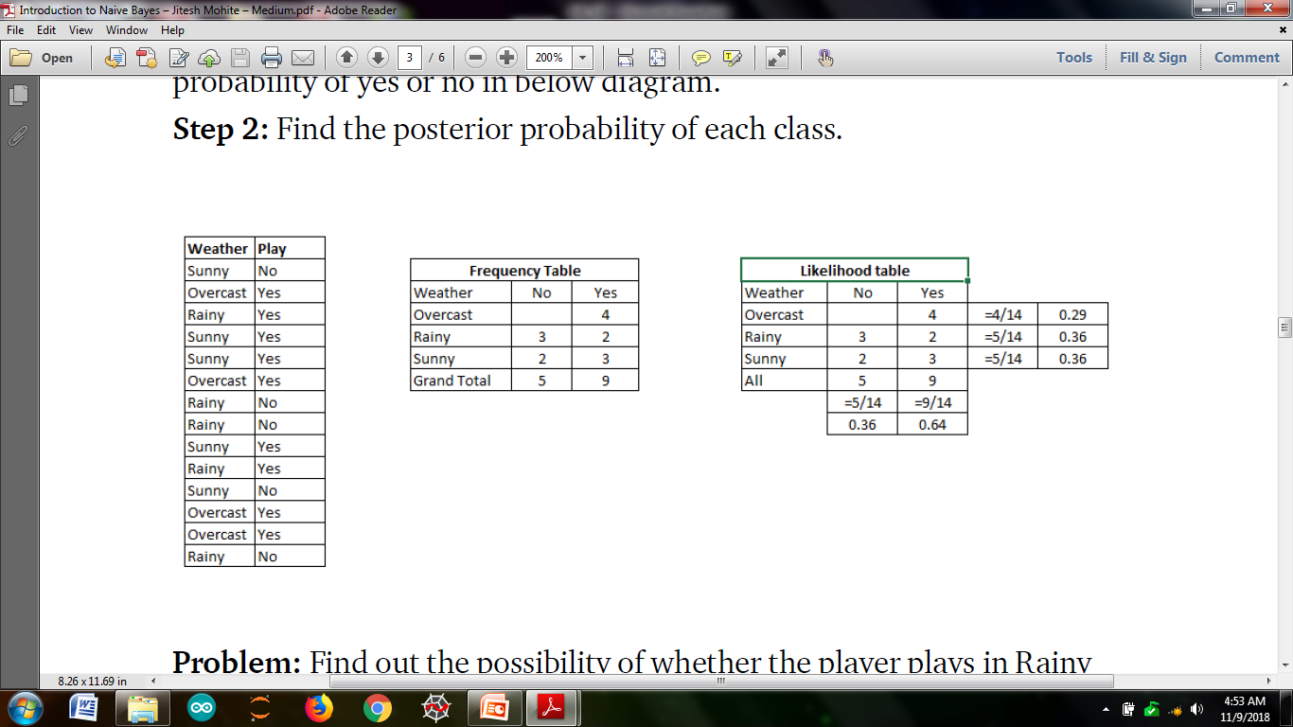
P(Yes|Rainy) = P(Rainy|Yes) * P(Yes) / P(Rainy)
P(Rainy|
Find out the possibility of whether the player plays in Rainy condition?
P(Yes|Rainy) = P(Rainy|Yes) * P(Yes) / P(Rainy)
(2/9*9/14 ) / (5/14 ) = 0.4
P(No|Rainy) = P(Rainy|No) * P(No) / P(Rainy) = (3/5*5/14)5/14= 0.6

Slide 28
Example 1 - Predict the outcome of a football world cup match on the basis of part performance data of playing teams
Weather condition | Wins in last 3 matches | Humidity | Win toss | won match
Rainy | 3 wins | High | FALSE | No
Rainy | 3 wins | High | TRUE | No
Overcast | 3 wins | High | FALSE | Yes
Sunny | 2 wins | High | FALSE | Yes
Sunny | 1 wins | Normal | FALSE | Yes
Sunny | 1 wins | Normal | TRUE | No
Overcast | 1 wins | Normal | TRUE | Yes
Rainy | 2 wins | High | FALSE | No
Rainy | 1 wins | Normal | FALSE | Yes
Sunny | 2 wins | Normal | FALSE | Yes
Rainy | 2 wins | Normal | TRUE | Yes
Overcast | 2 wins | High | TRUE | Yes
Overcast | 3 wins | Normal | FALSE | Yes
Sunny | 2 wins | High | TRUE | No

Slide 29
Step 1 – construct Frequency table
 | Won Match |  | Likelihood
Weather condition | Yes | No | P(Yes) | P(No)
Sunny | 3 | 2 | 3/9 | 2/5
Overcast | 4 | 0 | 4/9 | 0
Rainy | 2 | 3 | 2/9 | 3/5
Total | 9 | 5
 | Won Match |  | Likelihood
Humidity | Yes | No | P(Yes) | P(No)
High | 3 | 4 | 3/9 | 4/5
Normal | 6 | 1 | 6/9 | 1/5
Total | 9 | 5
 | Won Match |  | Likelihood
Win Toss | Yes | No | P(Yes) | P(No)
FALSE | 6 | 2 | 6/9 | 2/5
TRUE | 3 | 3 | 3/9 | 3/5
 | 9 | 5
 | Won Match |  | Likelihood
Wins in last 3 matches | Yes | No | P(Yes) | P(No)
3 Wins | 2 | 2 | 2/9 | 2/5
2 Wins | 4 | 2 | 4/9 | 2/5
1 Win | 3 | 1 | 3/9 | 1/5
Total | 9 | 5
Play |  | P(yes)/P(No)
Yes | 9 | 9/14
No | 5 | 5/14
Total | 14 | 100%

Slide 30
Step 2 : Classifier – To predict whether the team will with for the given conditions
Classify (Rainy, 2 wins, Normal, True)
Weather condition (a1) = Rainy, Wins in last 3 matches (a2) = 2 wins, Humidity (a3) = Normal and Win toss (a4) = True
Win match = yes | no = y|n
P(y|a1∩a2∩a3∩a4) = (P(a1|y) P(a2|y) P(a3|y) P(a4|y)P(y)) /
P(a1)*P(a2)*P(a3)*P(a4)
= 2/9 * 4/9 * 6/9 * 3/9 * 9/14
= 0.014109347
P(n|a1∩a2∩a3∩a4) = P(a1|n) P(a2|n) P(a3|n) P(a4|n)P(n) /
P(a1)*P(a2)*P(a3)*P(a4)
= 0.010285714

Slide 31
Step 3 : Normalize the above probabilities
P(Win match) = P(win match) / (P(win match)+P(!win match))
= 0.014109347 / (0.014109347 + 0.010285714)
=0.5783
P(!Win match) = P(!win match) / (P(win match)+P(!win match))
= 0.010285714 / (0.014109347 + 0.010285714)
= 0.4216
Sum of probabilities = 1
Conclusion : this shows that there is 58% probability that the team will win if the above condition is true for that particular day

Slide 32
Example 2: Predict the outcome to play a tennis on the basis of previous data set of 14 days
Day | Outlook | Temp | Humidity | Wind | Tennis?
D₁ | Sunny | Hot | High | Weak | No
D₂ | Sunny | Hot | High | Strong | No
D₃ | Overcast | Hot | High | Weak | Yes
D₄ | Rain | Mild | High | Weak | Yes
D₅ | Rain | Cool | Normal | Weak | Yes
D₆ | Rain | Cool | Normal | Strong | No
D₇ | Overcast | Cool | Normal | Strong | Yes
D₈ | Sunny | Mild | High | Weak | No
D₉ | Sunny | Cool | Normal | Weak | Yes
D₁₀ | Rain | Mild | Normal | Weak | Yes
D₁₁ | Sunny | Mild | Normal | Strong | Yes
D₁₂ | Overcast | Mild | High | Strong | Yes
D₁₃ | Overcast | Hot | Normal | Weak | Yes
D₁₄ | Rain | Mild | High | Strong | No

Slide 33
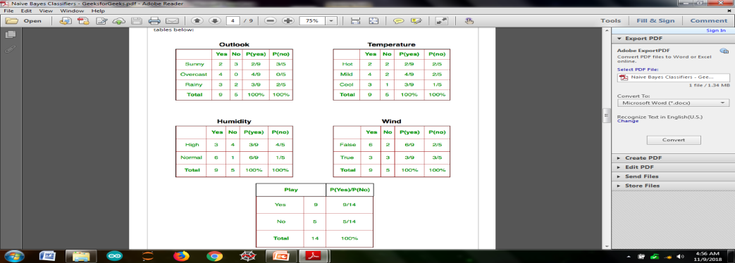

Slide 34
Example
Day | Outlook | Temp | Humidity | Wind | Tennis?
D₁ | Sunny | Hot | High | Weak | No
D₂ | Sunny | Hot | High | Strong | No
D₃ | Overcast | Hot | High | Weak | Yes
D₄ | Rain | Mild | High | Weak | Yes
D₅ | Rain | Cool | Normal | Weak | Yes
D₆ | Rain | Cool | Normal | Strong | No
D₇ | Overcast | Cool | Normal | Strong | Yes
D₈ | Sunny | Mild | High | Weak | No
D₉ | Sunny | Cool | Normal | Weak | Yes
D₁₀ | Rain | Mild | Normal | Weak | Yes
D₁₁ | Sunny | Mild | Normal | Strong | Yes
D₁₂ | Overcast | Mild | High | Strong | Yes
D₁₃ | Overcast | Hot | Normal | Weak | Yes
D₁₄ | Rain | Mild | High | Strong | No
Consider PlayTennis again
P (yes) = 9/14, P (no) = 5/14
P(Sunny|yes) = 2/9
P(Sunny|no) = 3/5
Classify: (sunny, cool, high, strong)
P(y)P(sunny|y)P(cool|y)P(high|y)P(strong|y) = 0.005
P(n)P(sunny|n)P(cool|n)P(high|n)P(strong|n) = 0.021

Slide 35
Applications of Naïve Bayes classifier
Text classification
Spam filtering
Hybrid recommender systems – machine learning and data mining techniques – eBay, Target, flipcart etc
Online sentiment analysis

